Slide 1

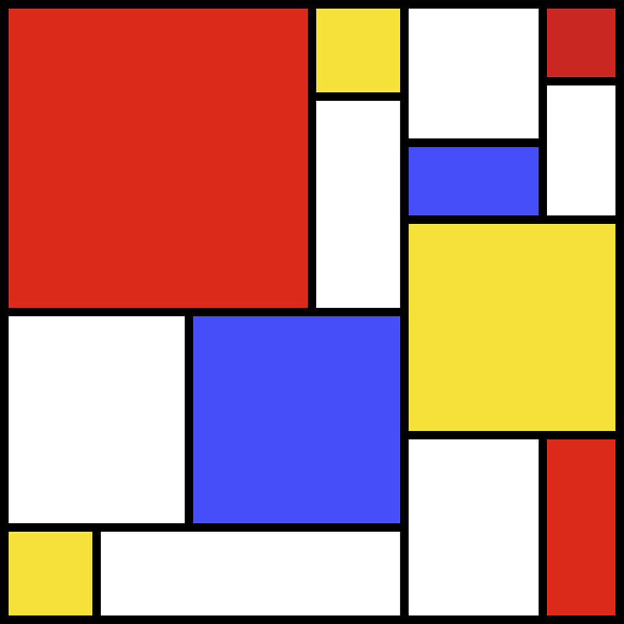

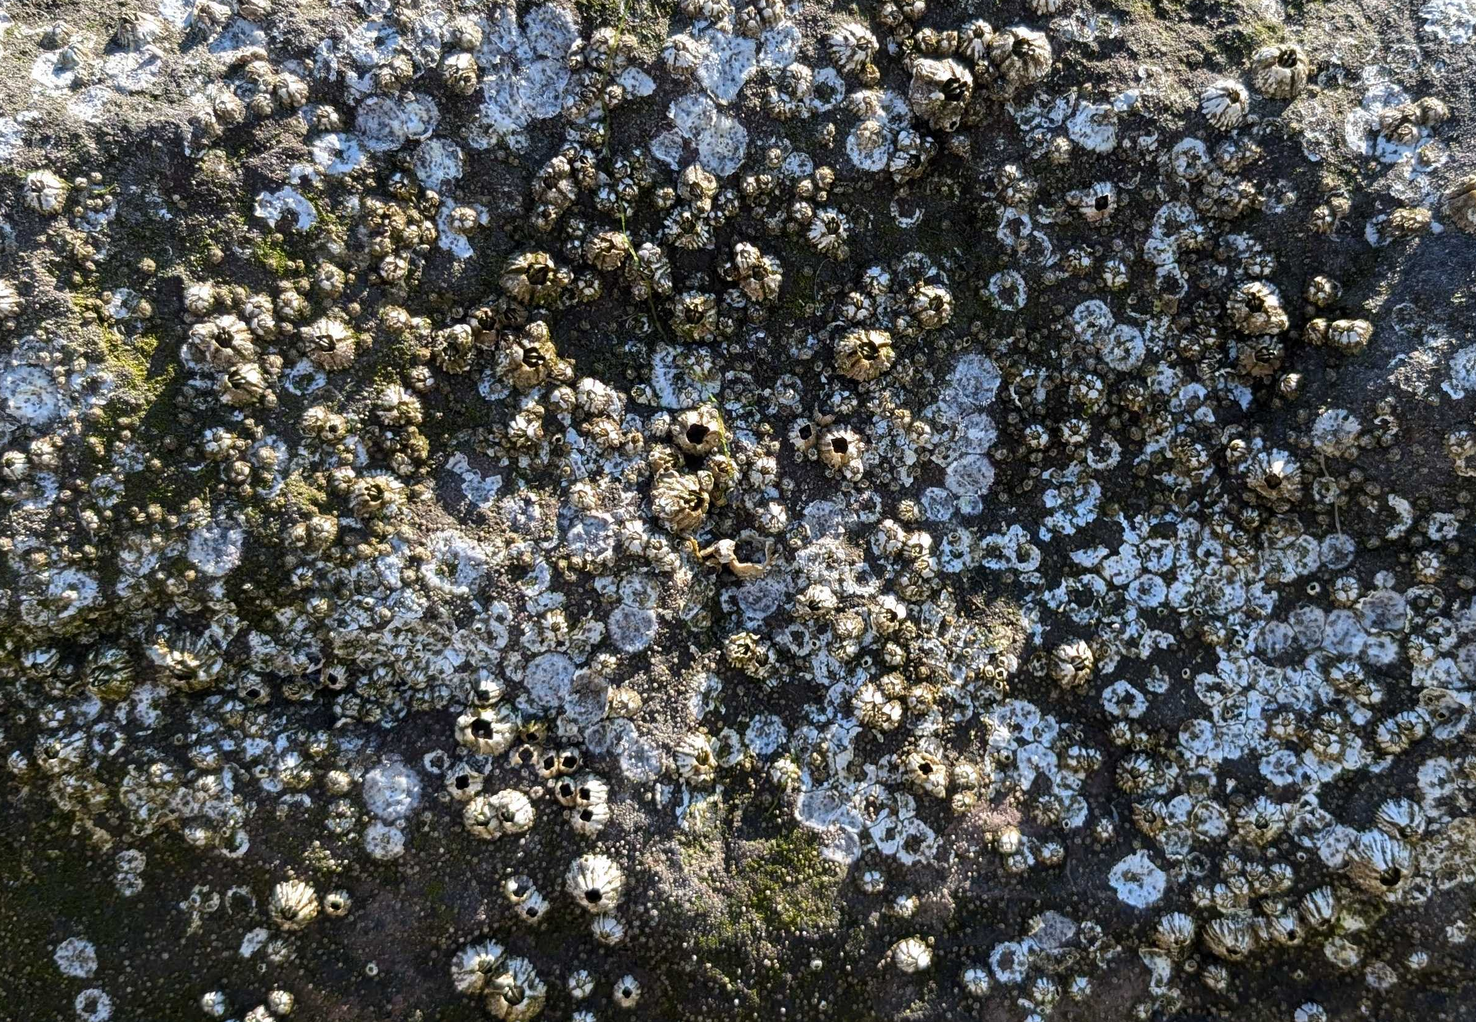
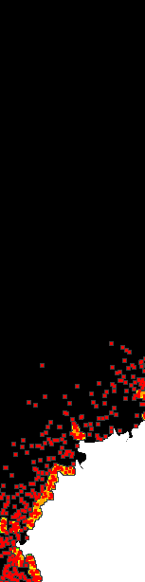
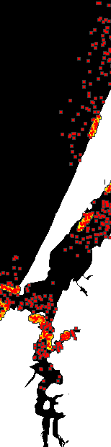

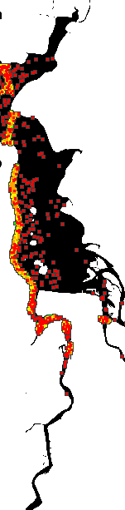
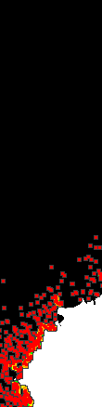
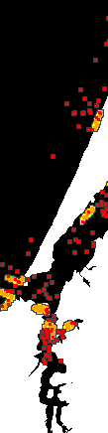
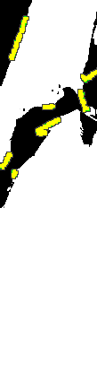
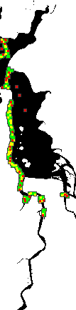
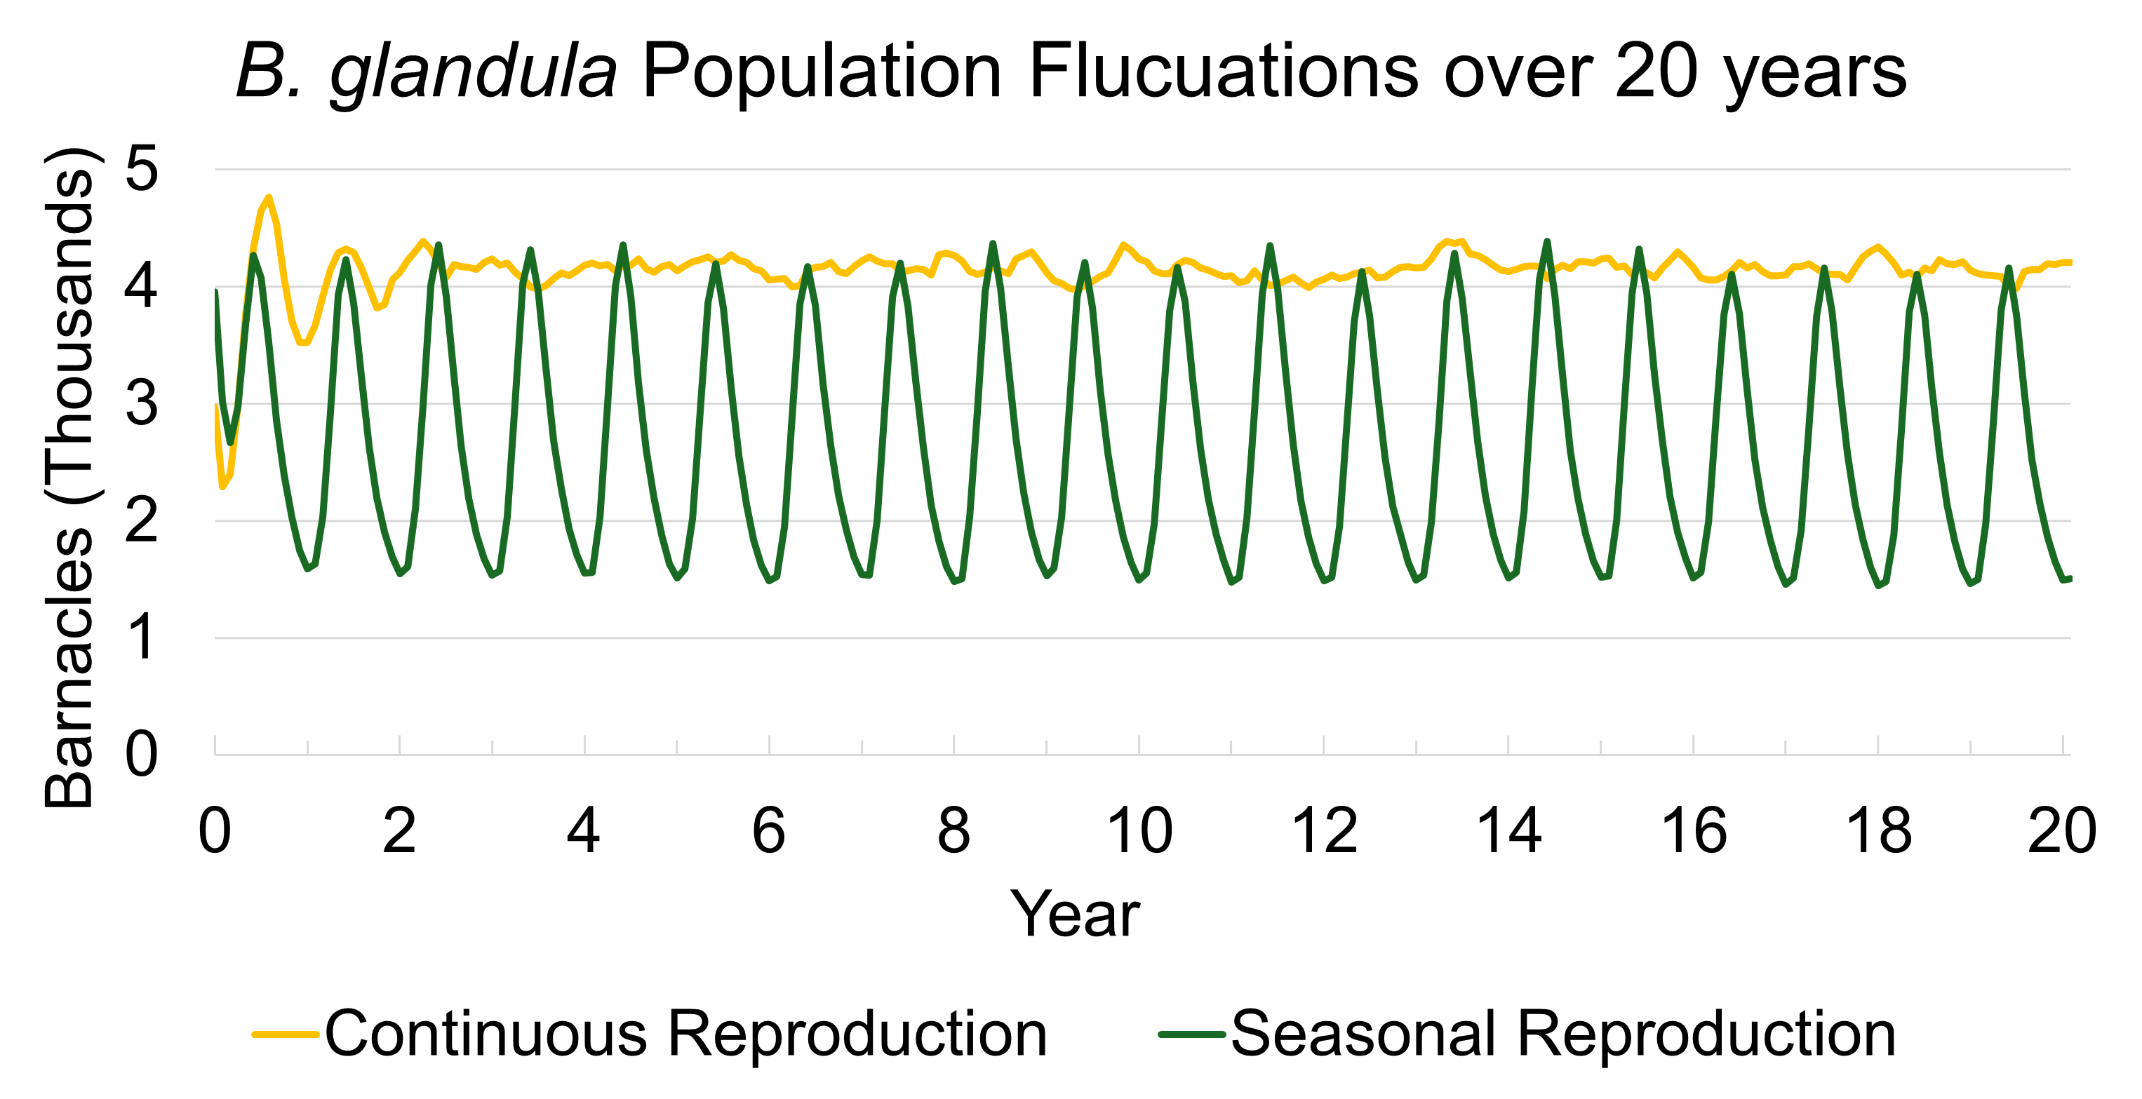
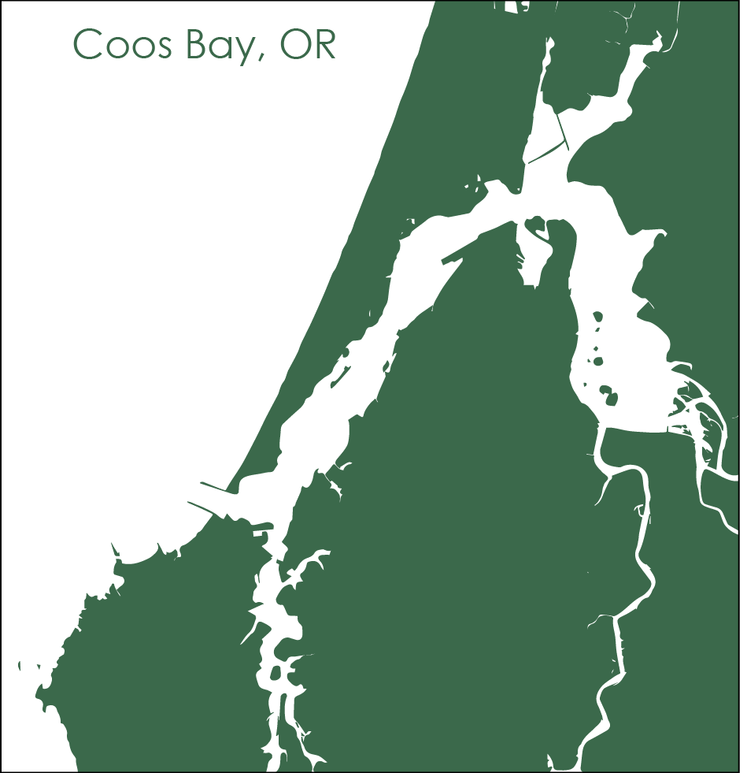
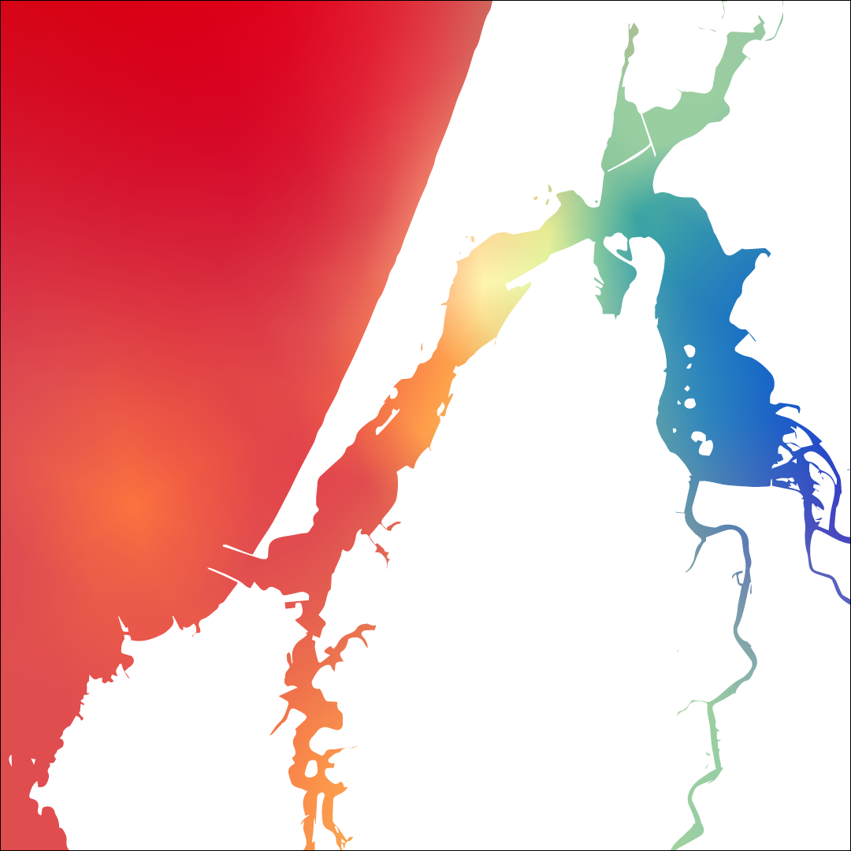
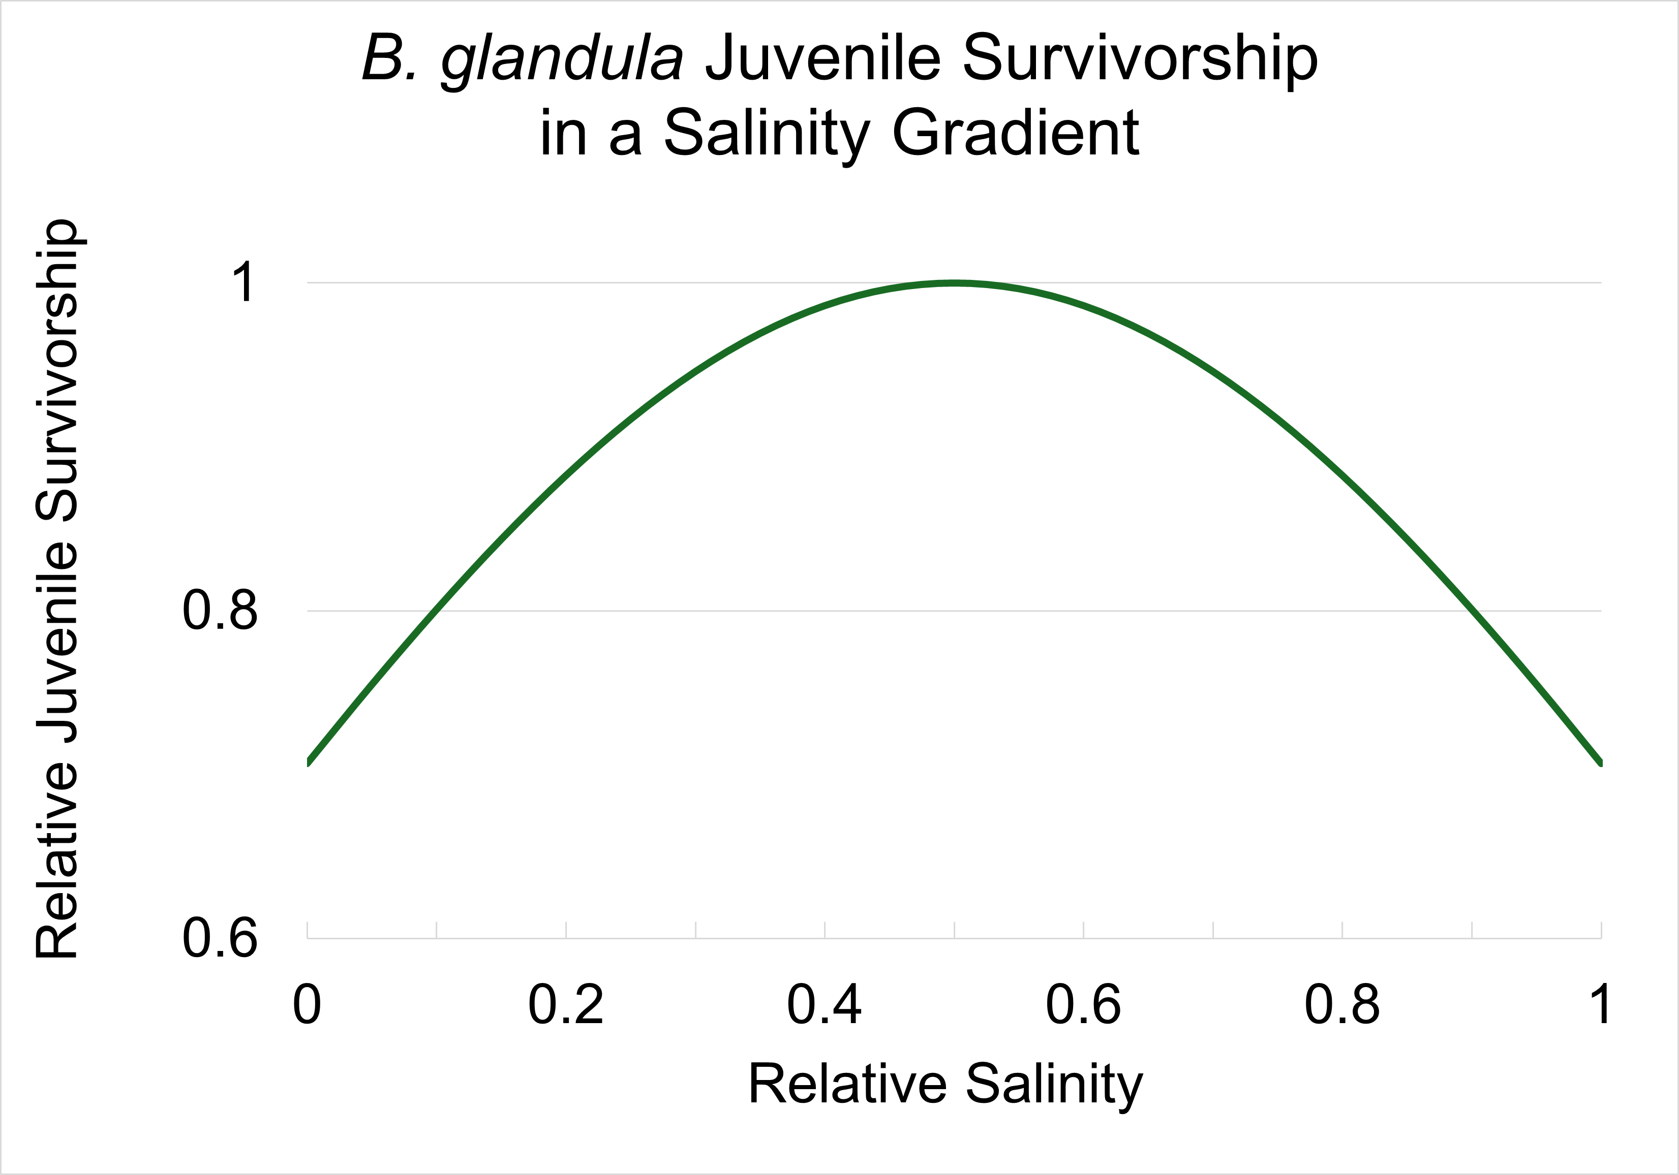
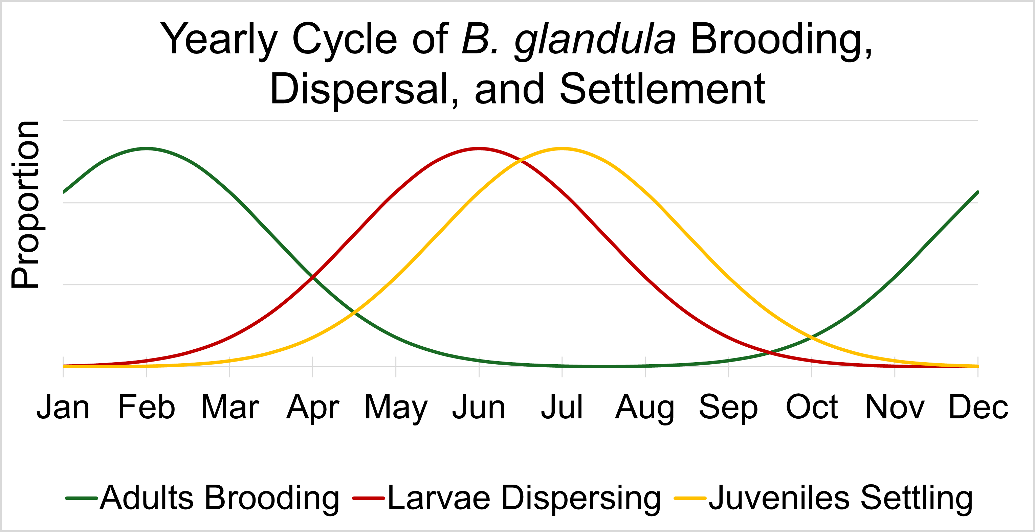
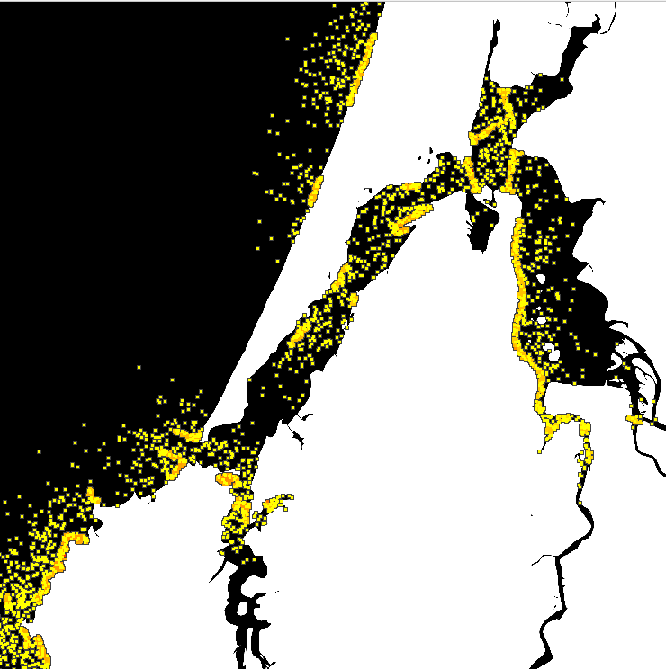
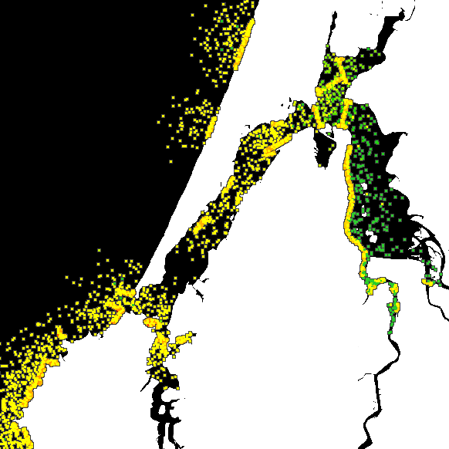
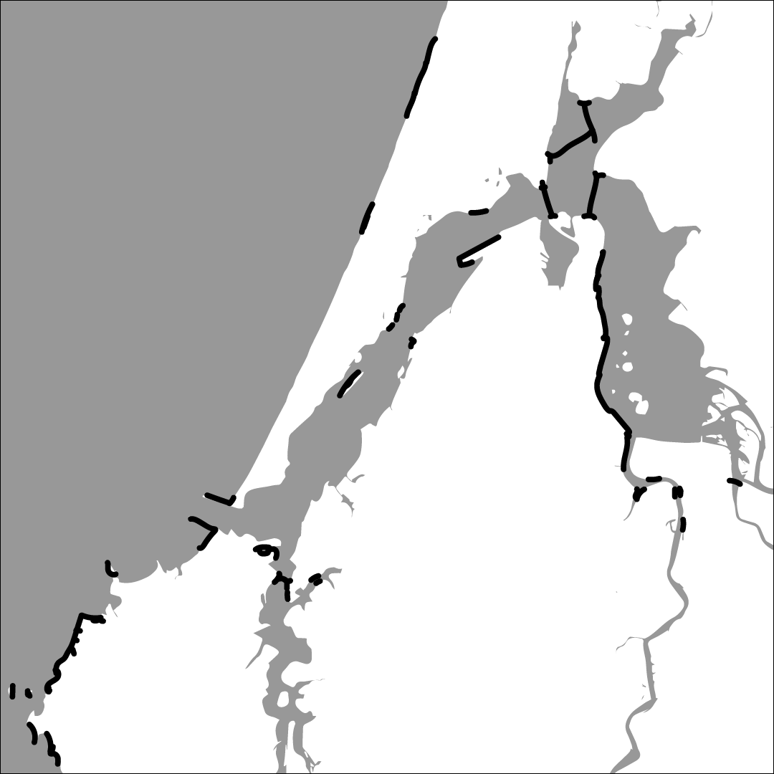
What a Load of Barnacles: A Spatial Genomic Simulation Measuring Evolution at Large Scales
Alex Bangs¹, Angel Rivera-Colón¹, Jiseon Min¹, Peter Ralph^{1,2}
¹ Institute of Ecology and Evolution, University of Oregon, Eugene, Oregon, USA, ² Department of Mathematics, University of Oregon, Eugene, Oregon, USA
It was the Pacific acorn barnacle in the Coos Estuary with a SLiM simulation!
How do we model population genomics for the Pacific acorn barnacle (Balanus glandula)?
Why do we care about modeling the Pacific acorn barnacle?
Reproduction
Sexual reproduction with neighbors, producing multiple broods a year
Seasonal brooding occurs in the late winter with larval dispersal occurring after ~4 months, during the summer
B. glandula Population Fluctuations over 12 months
Climate Change
Ocean acidification impacts carapace growth
Impacted by changing temperature and Salinity
Very numerous and widespread, good model organism for studying adaptation to changing environments
Continuous Reproduction
Seasonal Reproduction
Jun
Sept
Dec
Mar
Jun
Sept
Dec
Mar
Larvae
Juveniles
Adults
The Impacts of Salinity and Temperature
Current literature suggests that juvenile (recently settled) barnacles do best at salinities above 10 PSU, with highest survivorship at moderate salinities.
Adult barnacles have higher percent brooding (which translates to greater number of offspring) when water temperatures are lower
PLACE HOLDER FOR LOCAL ADAPTATION
Acknowledgments
Modeling Local Adaptation
B. glandula has limited dispersal capabilities, so populations see greater genomic divergence as the distance between them increases
No Local Adaptation
Local Adaptation to Low Salinity
Thank you to Erin Jesuit of the VonDassow Lab at OIMB for your help collecting and analyzing B. glandula samples. To the entirety of the Kern Ralph Co-Lab for being a wonderful group to collaborate and research with. To Ben Haller and Philipp Messer for the development of SLiM: An Evolutionary Simulation Framework. And to the University of Oregon Summer Program for Undergraduate Research and the Mary G. Alden Fellowship for the opportunity to pursue summer research.
References
To Be Added
Low Fitness
Moderate Fitness
High Fitness
Notes:
Less Code
- More emphasis on Barnacles, less emphasis on simulation
Center Important Question and Results
No need to separate Results and Methods if it flows better
More explanation of graphics

